Slide 1

Analysis, 3D modeling and dynamic simulation of the vehicle steering system in the VIOS car.
Name: Trịnh Tiến Long
ID: 1852047
Thesis Advisor: PhD. Ngô Đắc Việt
Ph.D Trần Đăng Long

Slide 2
Content Layout:
Introduction
Theorical basics
Parameter of model
Implementation Process
Result and discussion
Conclusion and future work

Slide 3
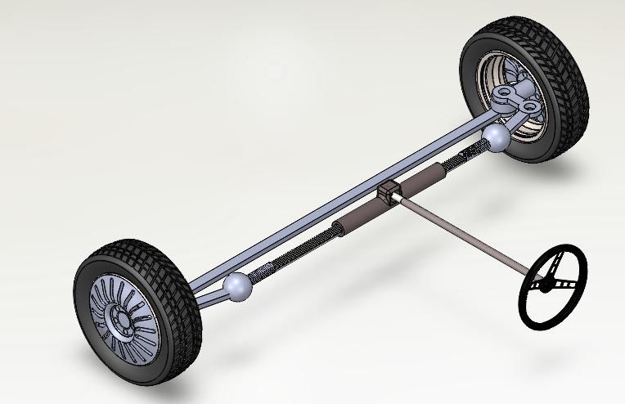
I. Introduction:
The steering system is designed to ensure proper kinematic turning of the vehicle.
The aim of this project is to simulate a steering system based on the parameters of a Toyota Vios car, in order to further study this mechanism.
Figure 1: Solidworks steering system
Notes:
Biểu diễn thông số trên 3d
+ sơ đồ nguyên lý khâu khớp
+ hình mô hình vios
Hình chụp -> khâu khớp -> 3d

Slide 4
I. Introduction:
Scope of implementation:
Focus on lower speed vehicle.
Mission summary:
_ Build 3D model of the steering system on Solidworks then import to Simscape to determine the torque acting on steering wheel with certain steering angle on EPS system
_Simulation of dynamic behavior in Matlab/Simulink with Simscape
_Validation the model for the control of an equivalent electric powered steering system
Notes:
This table outlines the scope of implementation and mission summary for a project related to the steering system. The focus is on lower speed vehicles. The mission involves building a 3D model of the steering system on Solidworks, importing it to Simscape to determine the torque acting on the steering wheel with a certain steering angle on the EPS system, simulating the dynamic behavior in Matlab/Simulink with Simscape, and validating the model for the control of an equivalent electric powered steering system.

Slide 5
I. Introduction:
The problem that needs to be solved.
Build 3D model of Steering System on Solidworks with parameters based on VIOS car at HCMUT Automotive Workshop
Link the model to Simulink Simscape and ensure that it is valid and functioning properly.
Prepare test cases for the steering system, including scenarios for changing the speed of the vehicle while steering from left to right, as well as lane-changing maneuvers.
The result that needs to be achieved.
Synthesis of a process of simulating a steering system using Simscape Multibody.
Analyze torque in – steering wheel angle relationship from above cases
Notes:
This table outlines the problem that needs to be solved, which involves building a 3D model of the Steering System on Solidworks based on VIOS car parameters at HCMUT Automotive Workshop, linking the model to Simulink Simscape, and preparing test cases for the steering system. The test cases should include scenarios for changing the speed of the vehicle while steering from left to right and lane-changing maneuvers. The desired result is a process of simulating a steering system using Simscape Multibody and analyzing the torque-steering wheel angle relationship from the test cases.

Slide 6
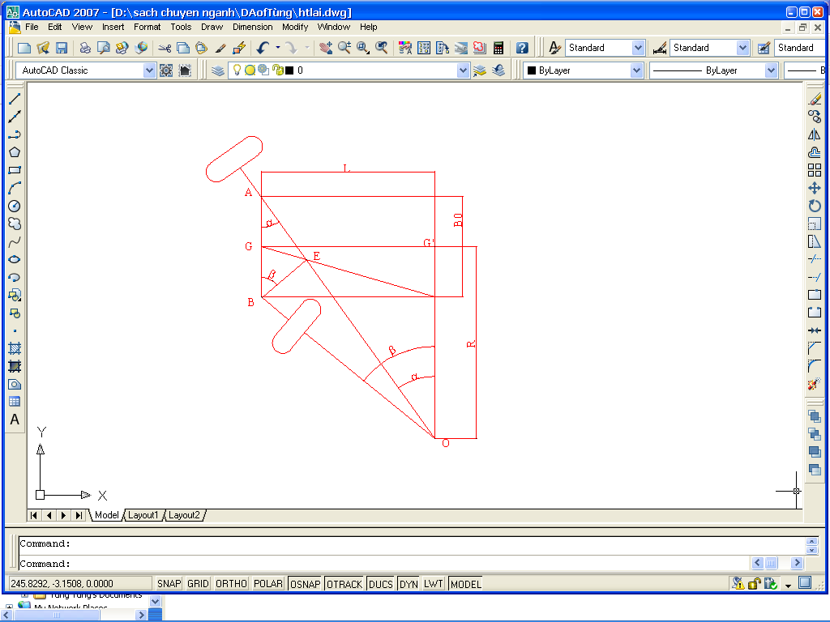
II. Theoretical steering basics:
Kinematics of the steering trapezium
Checking by algebraic method
Figure: A front-wheel-steering vehicle
Notes:
β_{i}: the turning angle of the inner steering wheel (degrees);
δi: the turning angle of the outer steering wheel (degrees);
L: the wheelbase of the vehicle (mm);
B₀: the track width of the vehicle (mm
The algebraic method evaluates the degree of lateral slipping through the coefficient δi, which is determined by the following formula

Slide 7
II. Theoretical steering basics:
β_{i}(degree) | α_{i} (degree) | δ_{i}
5 | 4,75 | 0,98
10 | 9,07 | 0,94
15 | 13,03 | 0,98
20 | 16,69 | 0,99
25 | 20,1 | 0,99
30 | 23,31 | 0,95
35 | 26,38 | 0,97
40 | 29,33 | 0,98
Table : Calculation result
Notes:
For the cars currently in use, the oscillation coefficient δi is within the range of δ = 0.9 to 1.07. Therefore, based on the calculation results, it can be seen that the steering trapezium of the vehicle, which has specifications similar to the Toyota Vios, ensures that the turning condition is met without lateral slipping.

Slide 8
III. Parameter of model
1) Parameter table:
Rack | Pinion: Rack ratio | Track Width
0.37m | 1:3 | 1.4m
Tie Rod | Steering Linkage | Radius of steering wheel
0.265m | 0.1m | 180mm
Steering gear ratio | Number of teeth on the pinion | Number of teeth on the rack
19.5 | 9 | 27
Notes:
This table presents the specifications of the steering system, including Rack, Pinion, Tie Rod, Steering Linkage, Steering Gear Ratio, and other technical parameters. Specifically, the Rack-Pinion system has a Rack ratio of 1:3, a track width of 1.4m, Tie Rod has a length of 0.265m, Steering Linkage has a length of 0.1m, and the radius of the steering wheel is 180mm. The Steering Gear Ratio is 19.5, the number of teeth on the Pinion is 9, and the number of teeth on the Rack is 27. These parameters are crucial in designing and evaluating the performance of the steering system.

Slide 9
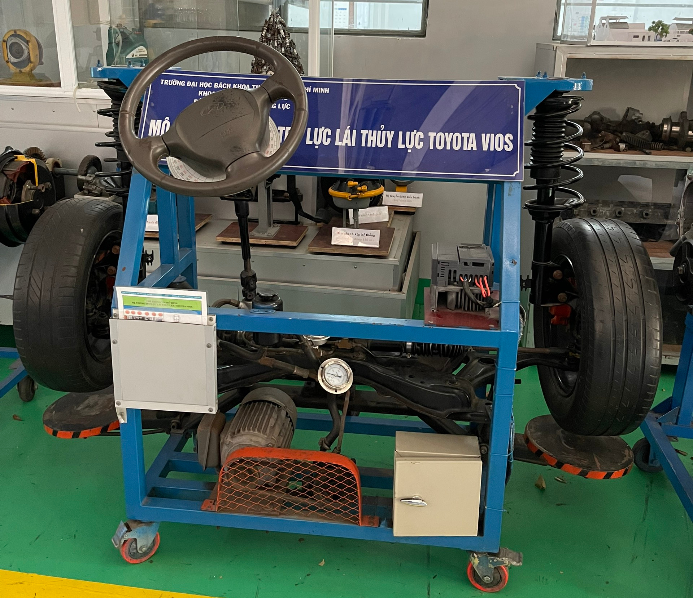
III. Parameter of model
Figure : Steering System Model at Automotive Workshop
Notes:
These parameters collect base on VIOS steering model at Automotive workshop
Đưa lên trên

Slide 10
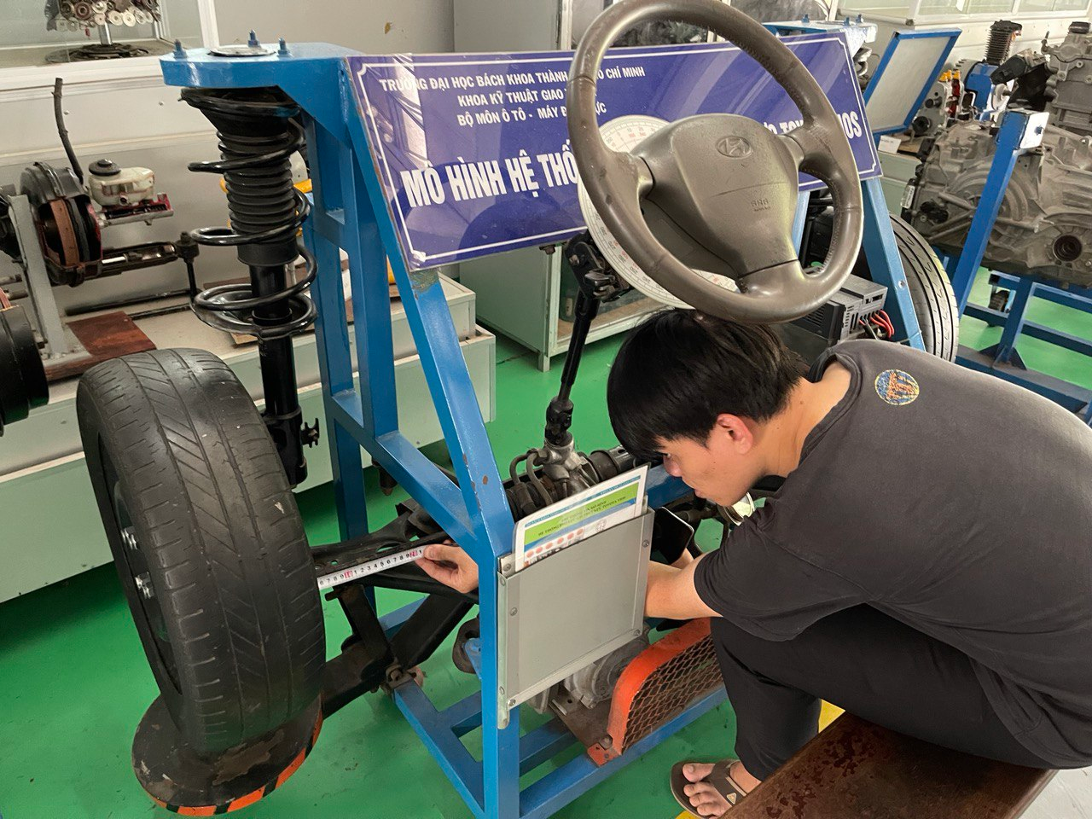
III. Parameter of model
Notes:
These parameters collect base on VIOS steering model at Automotive workshop

Slide 11
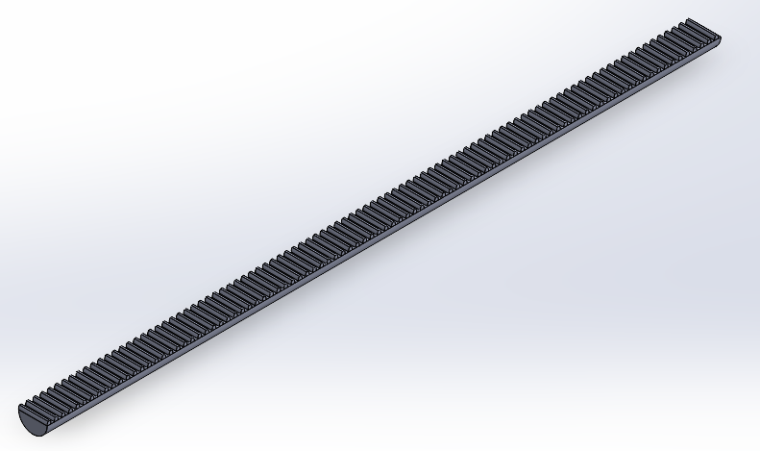
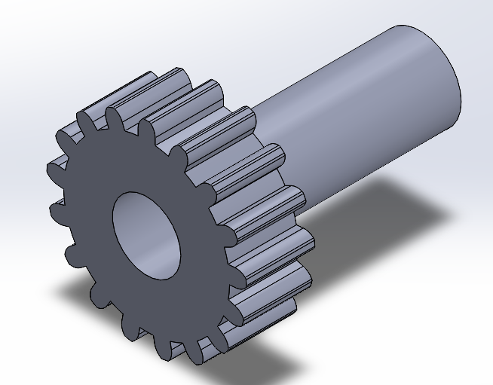
III. Parameter of model
2) Design of component:
Figure: Rack
Figure: Pinion
Notes:
Base on parameters above, models have been done using solidworks software

Slide 12
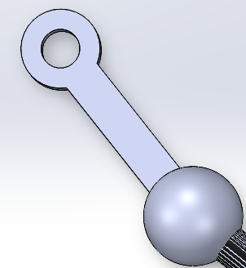
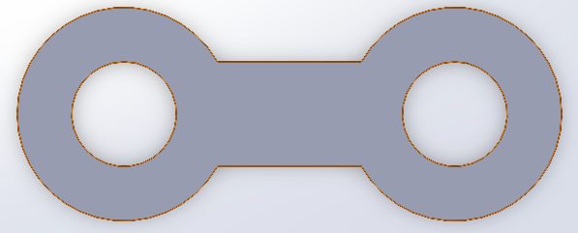
III. Parameter of model
2) Design of component:
Figure: Steering Linkage
Figure : Tie rod

Slide 13
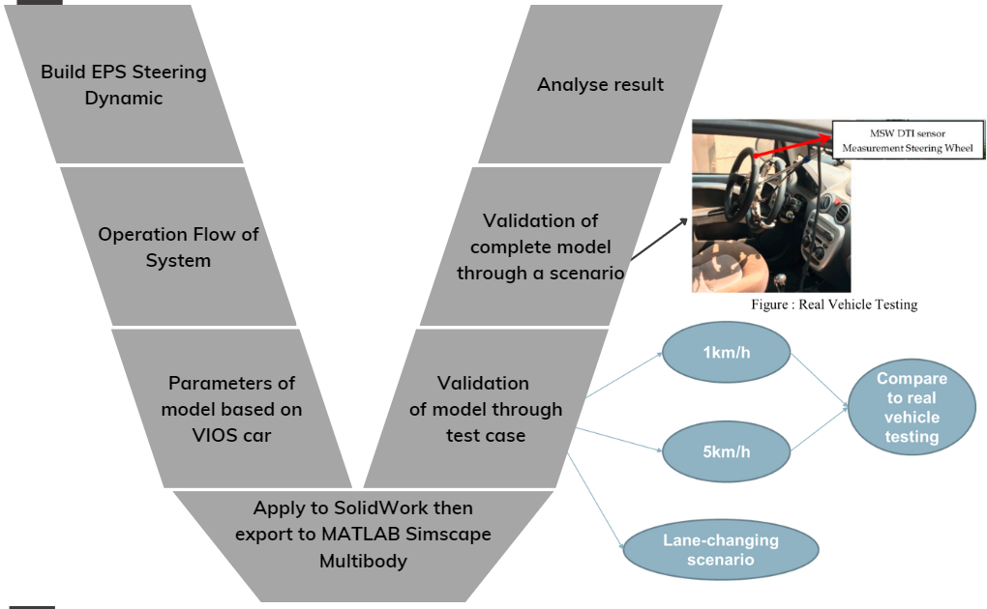
IV/ Implementation process
Figure : Process V model
Notes:
Chữ V nhóm dừng lại ở thiết kế, block số 3

Slide 14
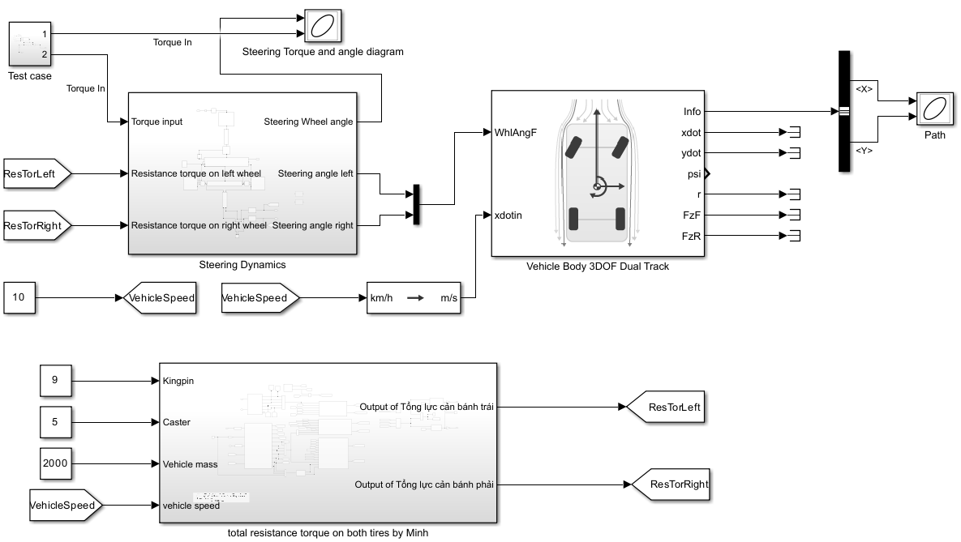
IV/ Implementation process
Figure: Complete model
Notes:
Nối block + màu
Mô hình tổng quát có motor(=0)

Slide 15
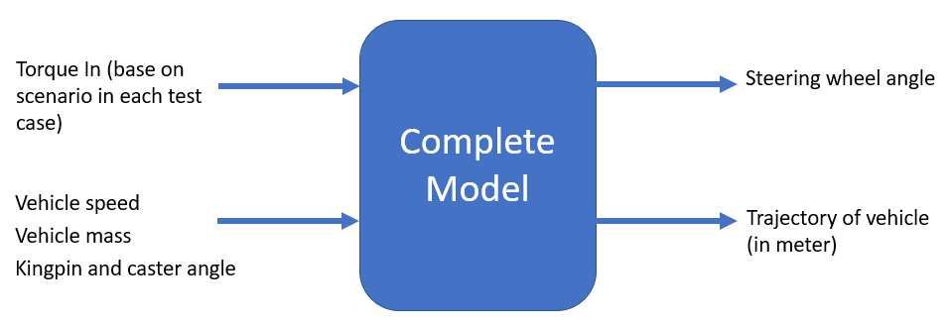
IV/ Implementation process
Figure: Operation Flow

Slide 16
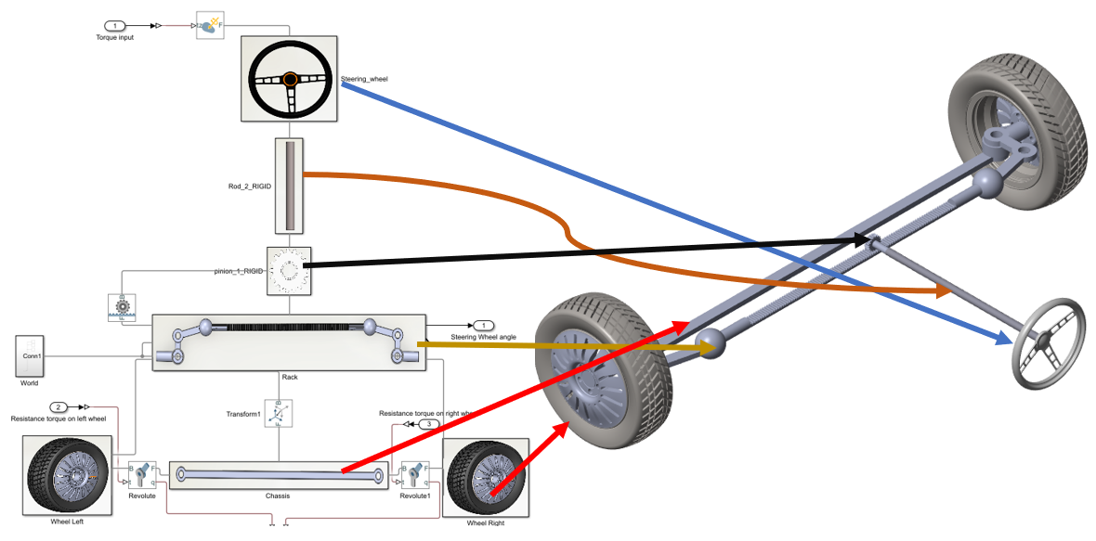
IV/ Implementation process
Notes:
Bỏ mũi tên

Slide 17
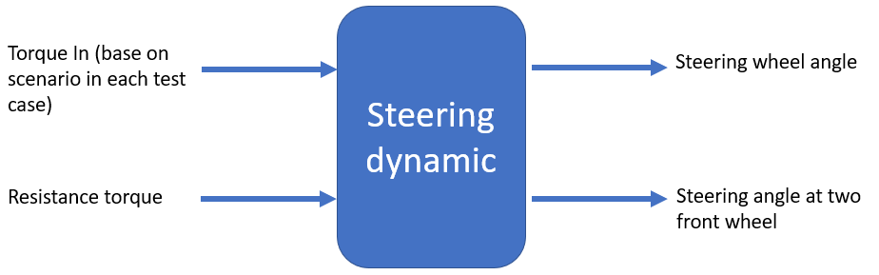
IV/ Implementation process
Figure: Operation Flow

Slide 18
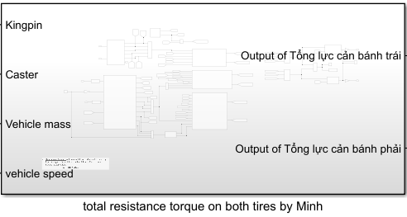
IV/ Implementation process
Figure: Total resistance torque

Slide 19
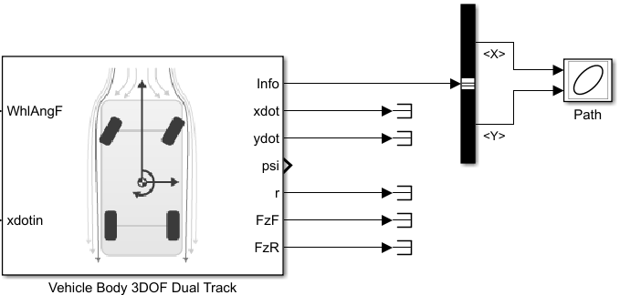
IV/ Implementation process
Figure: Vehicle Body 3DOF Dual Track

Slide 20
V/ Results and discussion:
1km/h
Compare to real vehicle testing
Test cases
5km/h
Lane-changing scenario

Slide 21
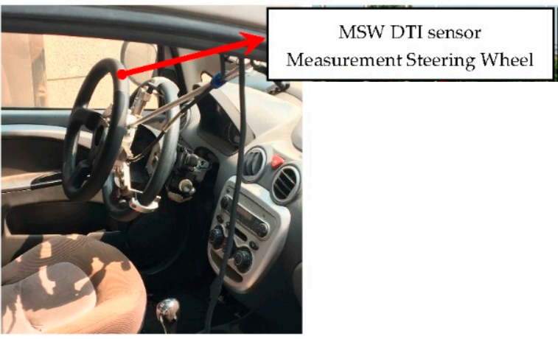
V/ Results and discussion:
Figure : Real Vehicle Testing

Slide 22
IV/ Implementation process
Parameter table:
Parameters | Value
Vehicle mass | 1520kg (full load)
Caster | 5 degree
Camber | 9 degree

Slide 23
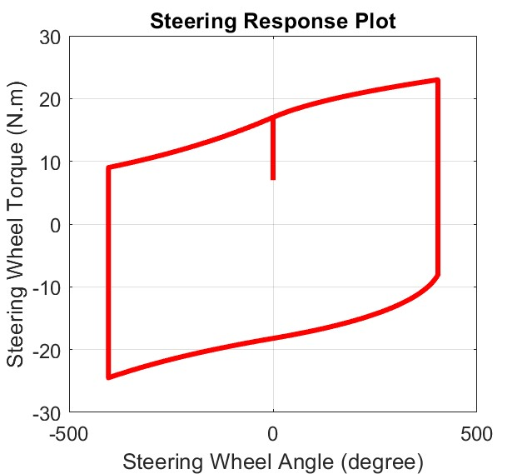
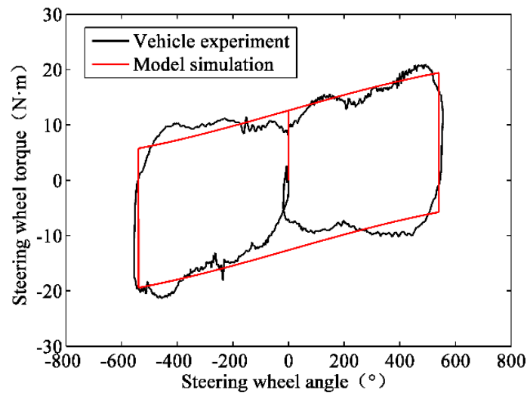
V/ Results and discussion:
1km/h
Notes:
Our goal is to turn the steering wheel all the way to the right, then to the left, and back to the center, which is called "full lock-to-lock". We started at a steering wheel angle of 0 degrees and simulated the process. The simulation results of 1km/h case shown on the left. We can compare these results to real car data when we change the vehicle speed later.

Slide 24
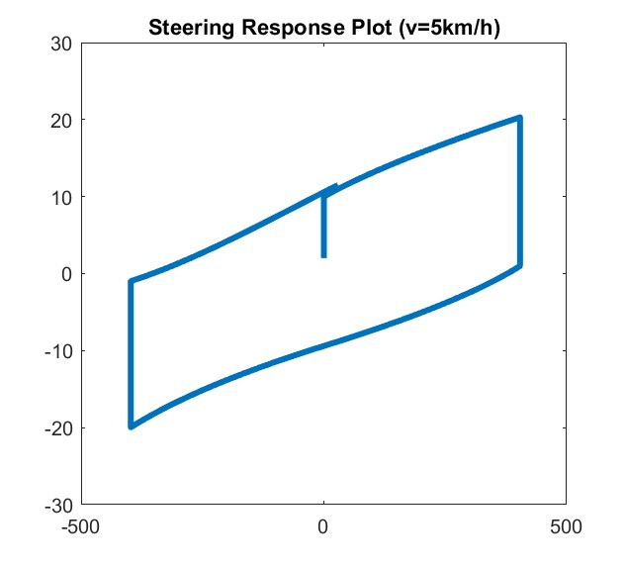
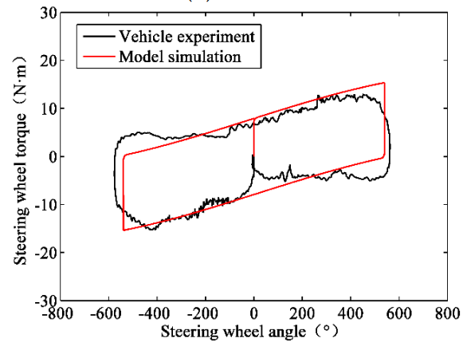
V/ Results and discussion:
5km/h
Notes:
When the speed is 5 km/h, we can see from the data that the size of the parallelogram is smaller than at 1 km/h in both diagrams.

Slide 25
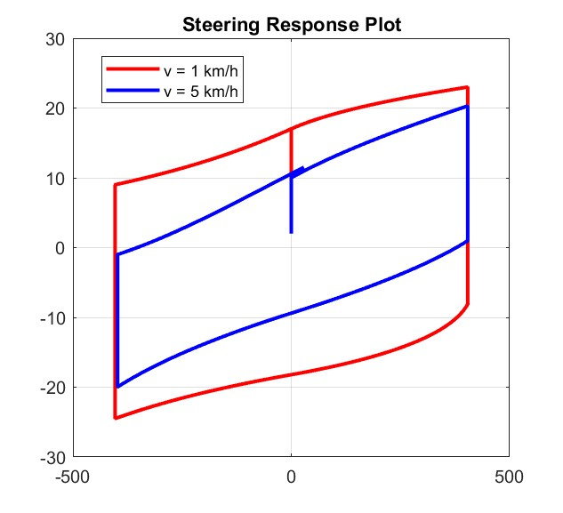
V/ Results and discussion:
Comparison
Notes:
let's compare the simulation results at 1km/h and 5km/h. We can see that less torque is needed to steer the vehicle at 5km/h compared to the 1km/h case.

Slide 26
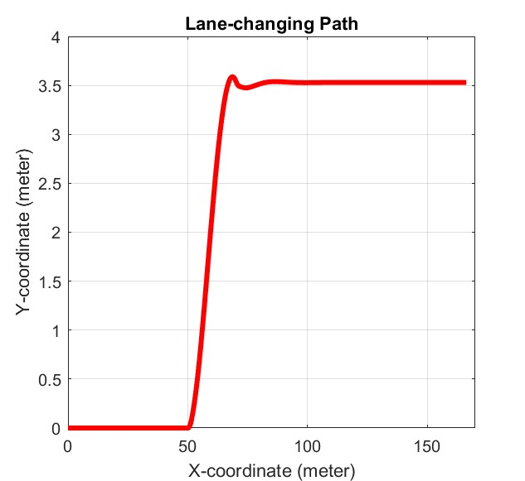
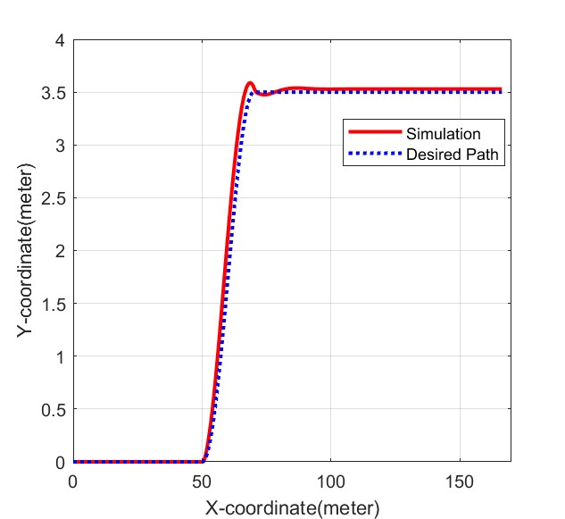
V/ Results and discussion:
Lane-changing scenario
Notes:
By using simulation model above (v=10km/h) , we achieved Left handside is diagram describes actual path that vehicle move along
Right handside is diagram that compare the differences between desired path and actual path from simulation
The vehicle tracked the predefined path accurately with minimal error, validating the accuracy of the simulation model in Simscape. This is important for designing and optimizing vehicle control systems. The successful execution of the predefined path indicates that the simulation model is reliable and can be used confidently in future development.
The two test cases have successfully demonstrated the process of building an EPS model using Solidworks and Simscape, simulating its dynamic behavior in Matlab/Simulink with Simscape, and validating the model for the control of an equivalent electric-powered steering system.

Slide 27
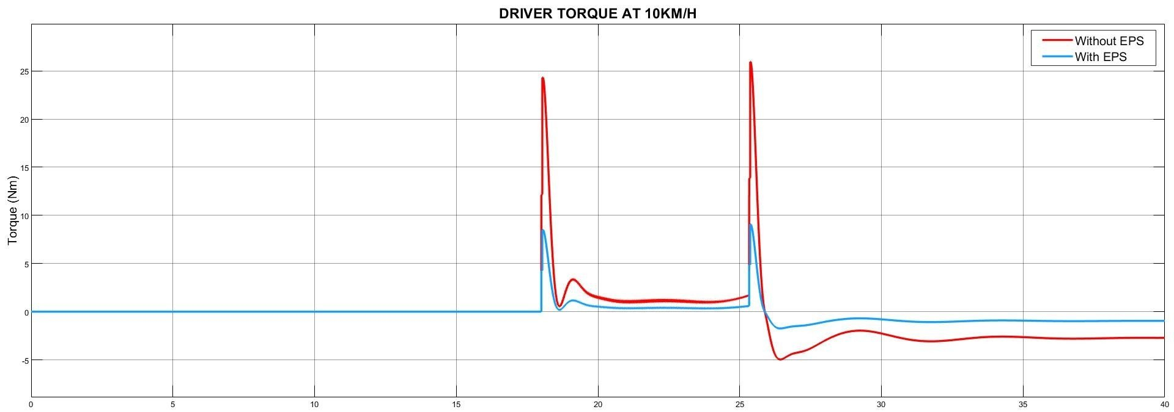
V/ Results and discussion:
Lane-changing scenario
Notes:
To stick to that path, driver need to input a torque like this
Thêm dk vận hành

Slide 28
VI/ CONCLUSION AND FUTURE PLAN
Through all the figures mentioned above, we can conclude that steering torque needed decreases when speed increases
The model is valid due to minor error between simulation result and real car result
Remove limitations in future testing and experimentation
Notes:
In conclusion, the objective of building and validating an EPS model using Solidworks and Simscape, and simulating its dynamic behavior in Matlab/Simulink with Simscape has been achieved. In order to improve the accuracy of the model, it is recommended to remove limitations in future testing and experimentation. Despite the limitation of the parameters based on the VIOS vehicle, the study demonstrates the potential of simulation models in optimizing vehicle control systems.

Slide 29
VI/ REFERENCE
Cossalter, Vittore. Motorcycle Dynamics. Lulu, 2010.
Genta. The Automotive Chassis. Springer International Publishing, 2020.
Hiremath, R. R., and Isha, T. B. “Modelling and Simulation of Electric Power Steering System Using Permanent Magnet Synchronous Motor.” IOP Conference Series: Materials Science and Engineering, vol. 561, no. 1, 2019, p. 012124, doi:10.1088/1757-899X/561/1/012124.
Jazar, Reza N. Vehicle Dynamics: Theory and Applications. Springer, 2008.
Nasir, M. Z., et al. “Hardware-in-the-Loop Simulation for Automatic Rack and Pinion Steering System.” Applied Mechanics and Materials, vols. 229-231, 2012, pp. 2135-2139, doi:10.4028/www.scientific.net/AMM.229-231.2135.
Nemes, Radu-Octavian, et al. “Integration of Real-Time Electric Power Steering System MATLAB/Simulink Model into National Instruments Veristand Environment.” 2018 IEEE 18th International Power Electronics and Motion Control Conference (PEMC), 2018, doi:10.1109/epepemc.2018.8521888.
Pacejka, Hans B. Tyres and Vehicle Dynamics. Butterworth-Heinemann, 2002.

Slide 30
VI/ REFERENCE
Qun, Zhang, and Juhua, Hu. “Modeling and Simulation of the Electric Power Steering System.” 2009 Pacific-Asia Conference on Circuits, Communications and Systems, 2009, doi:10.1109/PACCS.2009.67.
Ingale, Amol. “Modeling Mass-Spring-Damper System Using Simscape.” Journal of Engineering Research and Application, no. Preprint, no date, doi:10.9790/9622-0801033033.
Sh., A., H., E., and A., E.-H. “Side-Stick Control of Power Rack and Pinion Steering System.” The International Conference on Applied Mechanics and Mechanical Engineering, vol. 12, no. 12, 2006, pp. 383-396, doi:10.21608/amme.2006.41261.
Setiawan, A. and Baharom, M. R. "Development of Force Feedback in Steering Systems: A Review." Journal of Mechanical Engineering and Sciences, vol. 9, no. 1, 2015, pp. 1573-1586, doi:10.15282/jmes.9.1.2015.12.0147.
Tuan, N. A., and Thang, N. V. "Determining the Vertical Force When Steering." Journal of Science and Technology, vol. 55, no. 3, 2017, pp. 7-14, doi:10.15625/2525-2518/55/3/9129.

Slide 31
VI/ REFERENCE
Nguyen, V. H., et al. "Study on Low-Speed Steering Resistance Torque of Vehicles Considering Friction between Tire and Pavement." Journal of Mechanical Engineering Research and Developments, vol. 41, no. 4, 2018, pp. 51-60.
"Front Steering Gear Link." Toyota Vios / Soluna Vios, Japan Parts EU, 2010, http://www.japan-parts.eu/toyota/gr/2010/vios-soluna-vios/ncp42l-eepskr/2_149310_015/powertrain-chassis/4505_front-steering-gear-link/1.
Huu, Nguyen Ngoc and Quang, Tran Ngoc. "Real-Time Simulation of Electronic Power Steering System on TOYOTA VIOS." Proceedings of the 2nd Annual International Conference on Material, Machines and Methods for Sustainable Development (MMMS2020), edited by Bui Trong Long et al., Springer, 2021, pp. 273-281, doi:10.1007/978-3-030-69610-8_28.
Pang, Jong-Hyuk and Jang, Seong-Ho. "Steering Wheel Torque Control of Electric Power Steering by PD-Control." International Journal of Automotive Technology, vol. 12, no. 3, 2011, pp. 391-397, doi:10.1007/s12239-011-0050-5.

Slide 32
VI/ REFERENCE
Inallu, Prasanthi and Raju, G. Jaya Krishna. "Design of Steering Wheel Force Feedback System with Active Disturbance Rejection Control." 2018 International Conference on Circuit, Power and Computing Technologies (ICCPCT), 2018, pp. 1-5, doi:10.1109/ICCPCT.2018.8473152.
Sharma, R., Ganai, P., Pare, V., Kanchwala, H., Srihari, S.J. (2023). Validation of a Steering System Mathematical Model via Test Rig Measurements. In: Gupta, V.K., Amarnath, C., Tandon, P., Ansari, M.Z. (eds) Recent Advances in Machines and Mechanisms. Lecture Notes in Mechanical Engineering. Springer, Singapore. https://doi.org/10.1007/978-981-19-3716-3_13
Kang, Seung-Woo and Oh, Jung-Hwan. "Active Return-to-Center Control Based on Torque and Angle Sensors for Electric Power Steering Systems." International Journal of Automotive Technology, vol. 22, no. 6, 2021, pp. 1867-1874, doi:10.1007/s12239-021-0177-7.
Đặng, Quý. Tính Toán Thiết Kế Ôtô. NXB Hồ Chí Minh, 2001.

